Slide 1


Group members
Arbaz Hamid Bamboowala

Slide 2
INDEX
1) Introduction
2) Data Collection
3) Dimensional Modeling Design
4) Dimension Tables
5) Fact Tables
6) Creating Data Warehouse
7) Weather Datawarehouse E-R Diagram
8) Historic Weather Condition in Dallas
9) 5 Days Weather Forecast from Tableau
10) Conclusion

Slide 3

What is Weather Forecasting?
Why is Weather Forecasting Useful?
How do we perform Weather Forecasting?

Slide 4
Data Collection
 | Temperatures
 | Maximum | Minimum | Average | Departure
Nov-20 | 71.6 | 49.2 | 60.4 | 4
Dec-20 | 60.7 | 37.3 | 49 | 0.9
Jan-21 | 56.6 | 38.4 | 47.5 | 1.2
Feb-21 | 50.8 | 31.4 | 41.1 | -9.4
Mar-21 | 72.2 | 50.6 | 61.4 | 3.2
Apr-21 | 74.4 | 54.8 | 64.6 | -1
May-21 | 79.5 | 64 | 71.8 | -2.2
Jun-21 | 91.2 | 73 | 82.1 | 0.2
Jul-21 | 93.9 | 75.5 | 84.7 | -1
Aug-21 | 94.3 | 75.9 | 85.1 | -0.6
Sep-21 | 91.7 | 69.2 | 80.5 | 2
Oct-21 | 83.2 | 60.8 | 72 | 4.3
Nov-21 | 69.1 | 46.3 | 57.7 | 1.3
Temperature:
Maximum
The highest temperature for the day.
Minimum
The highest temperature for the day.
Average
The Average temperature for the day.
Departure
The difference between the 30-day mean temperature for that day and the average temperature.
Heating/Cooling Degree Day
Measurement designed to quantify the demand for energy needed to heat/cool the area.
Precipitation
Amount of rain/snow/sleet that falls.

Slide 5
Dimensional Modeling Design
Step 1 – Select Business Process
What has weather been like in Dallas historically and can we use that to predict weather over the next 5 days?
Step 2 – Declare Granularity
The granularity will be represented by the weather (temperature, precipitation) on an individual day.
Step 3 – Select Dimensions
The dimensions will be Date, Temperature, Precipitation, and Degree Day
Step 4 – Identify the Facts
The facts will be Additive numbers as Averages
Average Temperature, Average Precipitation, Average Heating Degree Day, Average Cooling Degree Day, Average New Snow, and Average Snow Depth

Slide 6
Dimension Tables
DimTemperature
Name | Data Type | Key
TemperatureKey | INT | Primary Key
DateKey | INT | Foreign Key
MaximumTemperature | FLOAT
MinimumTemperature | FLOAT
AverageTemperature | FLOAT
DepartureTemperature | FLOAT
DimDate
Name | Data Type | Key
DateKey | INT | Primary Key
FullDate | DATE
MonthKey | INT
Year | INT
DayOfMonth | INT
DimPrecipitation
Name | Data Type | Key
PrecipitationKey | INT | Primary Key
DateKey | INT | Foreign Key
Precipitation | FLOAT
NewSnow | FLOAT
SnowDepth | FLOAT
DimDegreeDay
Name | Data Type | Key
DegreeKey | INT | Primary Key
DateKey | INT | Foreign Key
HeatingDegreeDay | INT
CoolingDegreeDay | INT

Slide 7
Fact Table
FactAverageWeather
Name | Data Type | Key
AverageKey | INT | Primary Key
DateKey | INT | Foreign Key
TemperatureKey | INT | Foreign Key
PrecipitationKey | INT | Foreign Key
DegreeKey | INT | Foreign Key
AveragePrecipitation | FLOAT
AverageTemperature | FLOAT
AverageHeatingDegree | INT
AverageCoolingDegree | INT
AverageNewSnow | FLOAT
AverageSnowDepth | FLOAT

Slide 8
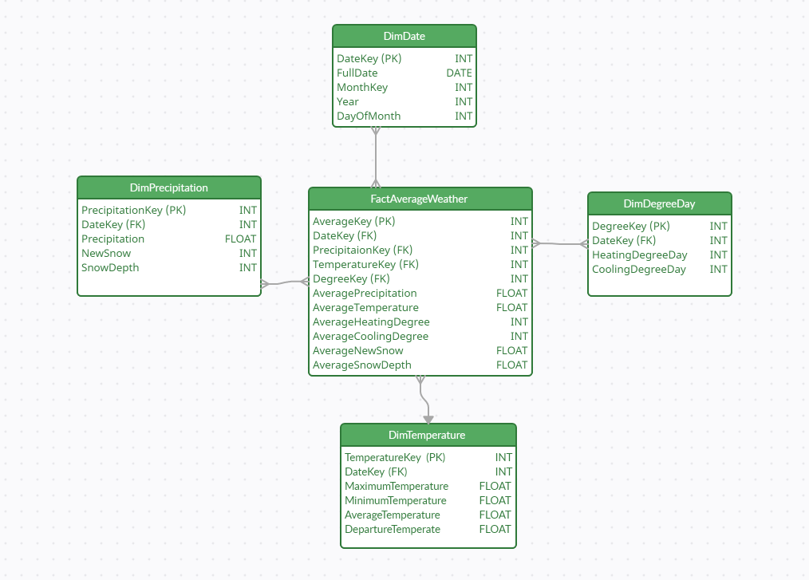
Weather DW Entity-Relationship Diagram

Slide 9
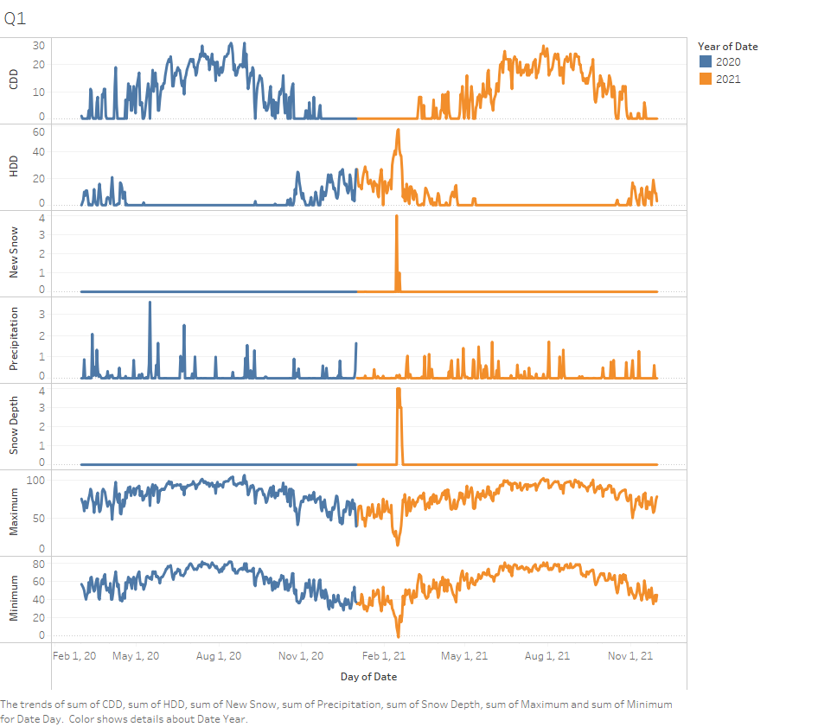
Historic Weather condition in Dallas
from March 2020-November 2021

Slide 10
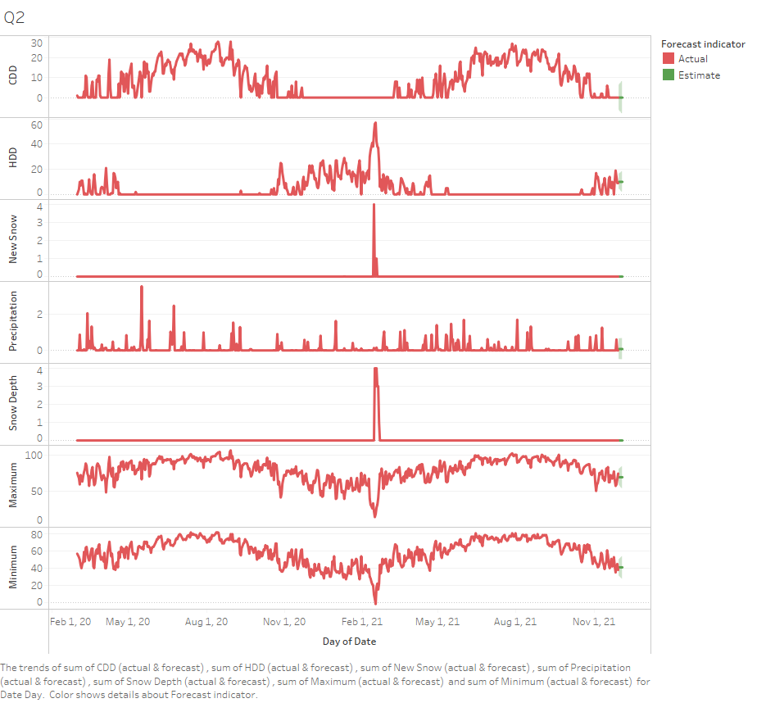
5 Days weather forecast from tableau

Slide 11
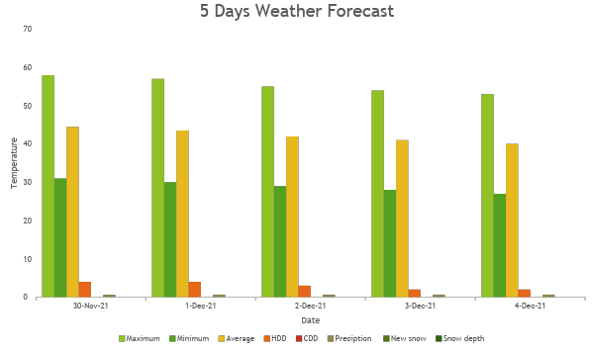

Slide 12
5 Days Weather Forecast
Date | Maximum | Minimum | Average | HDD | CDD | Preciption | New snow | Snow depth
30-Nov-21 | 58 | 31 | 44.5 | 4 | 0 | 0.657029 | 0 | 0
1-Dec-21 | 57 | 30 | 43.5 | 4 | 0 | 0.659919 | 0 | 0
2-Dec-21 | 55 | 29 | 42 | 3 | 0 | 0.662794 | 0 | 0
3-Dec-21 | 54 | 28 | 41 | 2 | 0 | 0.665655 | 0 | 0
4-Dec-21 | 53 | 27 | 40 | 2 | 0 | 0.668502 | 0 | 0

Slide 13
CONCLUSION
The Data warehouse is built to pull the historical and upcoming weather reports for Dallas, TX.
►Database designed, structured and normalized in a way to use unlimited city forecasts as well, not limited with specific cities.
►The dimensional modeling is designed by four chief steps to fulfill the business requirements. Dim Table which has its own Primary Key(PK) and Fact Table is derived value from Dim table via Foreign Key(FK).
►The most convenient application MS SQL server used for building data warehouse by writing sql queries, secondly MS Visual Studio to build SSIS to load the data from CSV file and construct a fact table.
►Entity Relationship Diagram helped to showcase the accurate picture of connections between tables.
In spite of all this, we used Tableau application to showcase the data in various outline graphs to get one look at the entire designed data.

Slide 14

QUESTIONS?

Slide 15


